Slide 1
Client Success Study
InnoFlex Solutions Unlocks Capacity With Automation For Midwest Producer
Driving Sales Potential in Future Years

Slide 2
The Problem & Opportunity
Company
Context
Problem statement
A premium leader in plant-based products is positioning for strategic physical expansion and sales growth in the Midwest.
Key markets are retail and wholesale.
This industry is on a growth trajectory where consumers are demanding variety, convenience, and accessibility.
Sales growth is constrained due to current manual hand packaging operations.
Compounded by labor challenges- inefficiencies, low throughput and capacity
.

Slide 3
Challenges Overview
Challenge 1
Challenge 2
Challenge 3
Existing Operations
Multiple product and packaging formats
Various upstream process reguirements and regulation.
Batch mode production and product tracking
Capital Equipment Cost
COGs based on labor rightsizing and volume increase
Flexibility without sacrificing throughput
Payback period – aligned with the company's internal finance metrics
Change Management
Minimal automation to higher % of automation
Transformation to technology not used today
Culture and people training

Slide 4
Solution – Phase One
The client leveraged InnoFlex Solutions to perform a detailed Preliminary Engineering Model to Quantify:
Cost (Reduce labor with Automation)
Flexibility Options
The Right Suppliers
Assess the Correct Levels of Automation for Sustainability and Business Sales Growth

Slide 5
Why InnoFlex Solutions, LLC Was Selected
Nimble Organization
More than 30 years industry experience and more than 100 years of combined team experience
Background in Automation with CPGs, Food-Beverage, and OEM Industry
Project Management and problem solving in the initial assessment
Installed and started up packaging production lines globally
Access to a network of industry experts
Deliver results on time, on budget, with sustainable results
We collaborate with the client and build trust

Slide 6
Implementation

Slide 7
End Q2: Assess The Opportunity
Preliminary Baseline Recommendations and Won the Business
Q4: Summary review with the Client internal Stakeholders, Achieved the COG’s, Payback, and Volume Goals
06/21
07/21
09/21
10/21
12/21
Client Site Visit – Review the Operations and Synergies to Work Together
End Q3: Preliminary Engineering, Equipment Costs, Systems Vetting and Supplier Engagement

Slide 8
Impact
Projection
200% Potential Sales Increase
Operational Capacity Improvement
With Automation

Slide 9
Overall Projected Volume From Year 1 to 3:
200% Throughput Increase

Slide 10
Overall Summary - Results

Slide 11
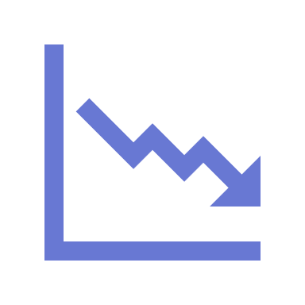
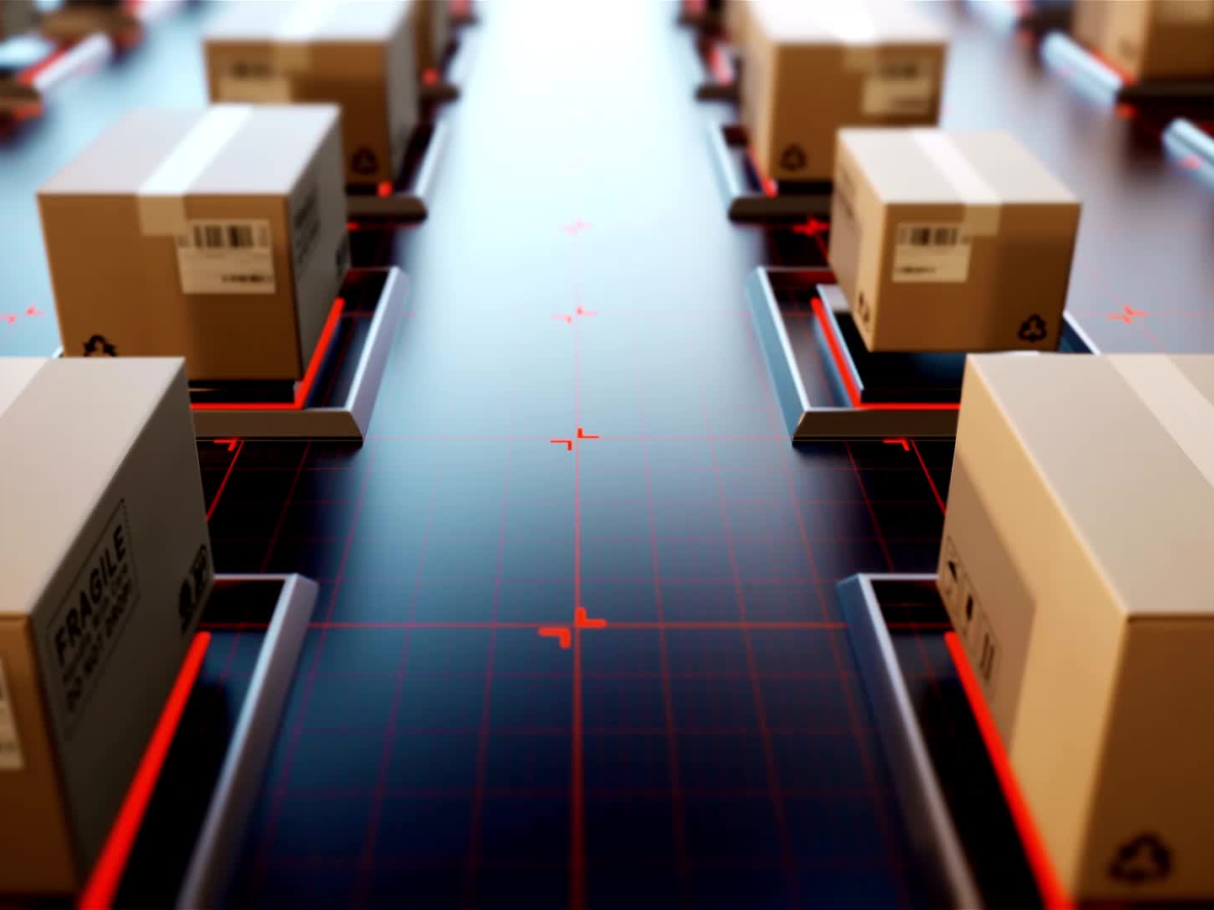
Key InnoFlex Solutions, LLC Goals Achieved
$ CapEx Cost
Reduced initial CapEx cost by over 40 %
With Flexible Option
$ Savings
Reduced Labor Costs by nearly
75 %
Sales – Growth
Created an Automation Roadmap to Exceed the Year Over Year Volume Plans - Forecasts

